Slide 1

Machine learning

Slide 2
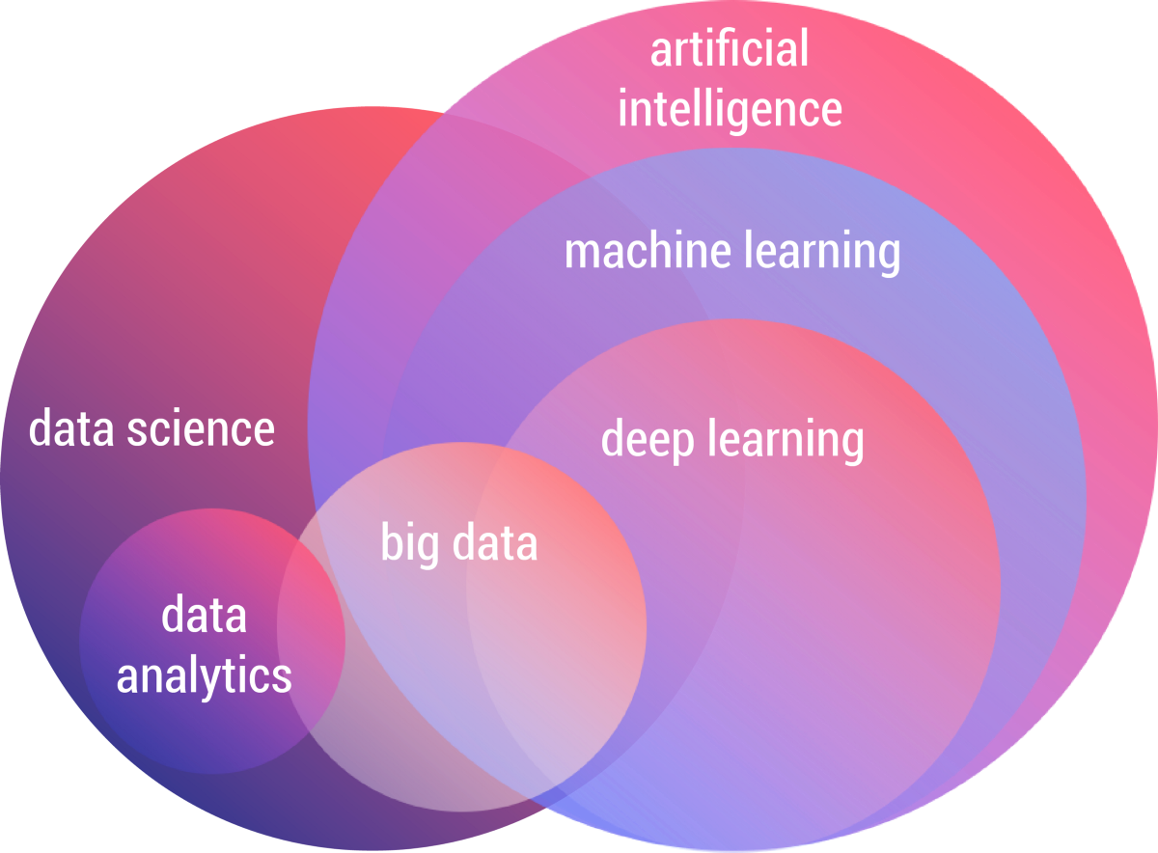

Slide 3
ML
Machine learning
Machine learning uses artificial intelligence to enable machines to learn and predict outcomes more accurately without being explicitly programmed to do so. This makes them more similar to humans. The machine learning models continuously learns and improves its performance with the use of necessary data.

Slide 4
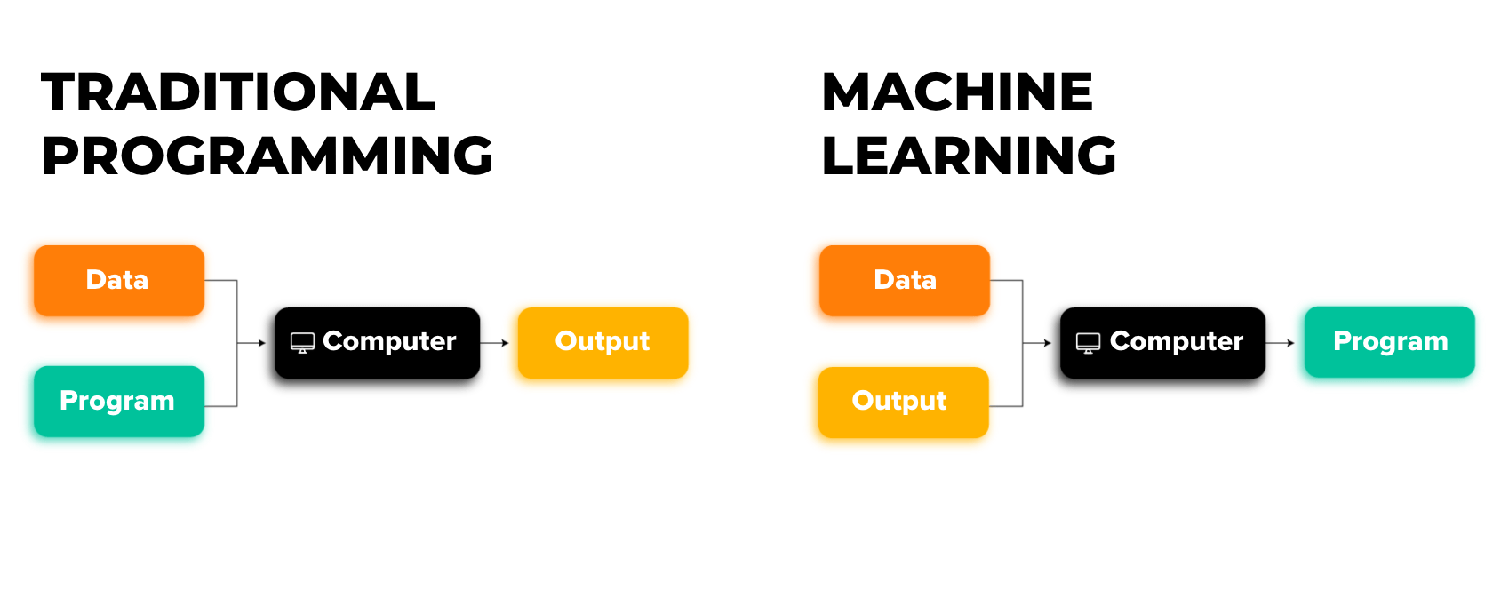
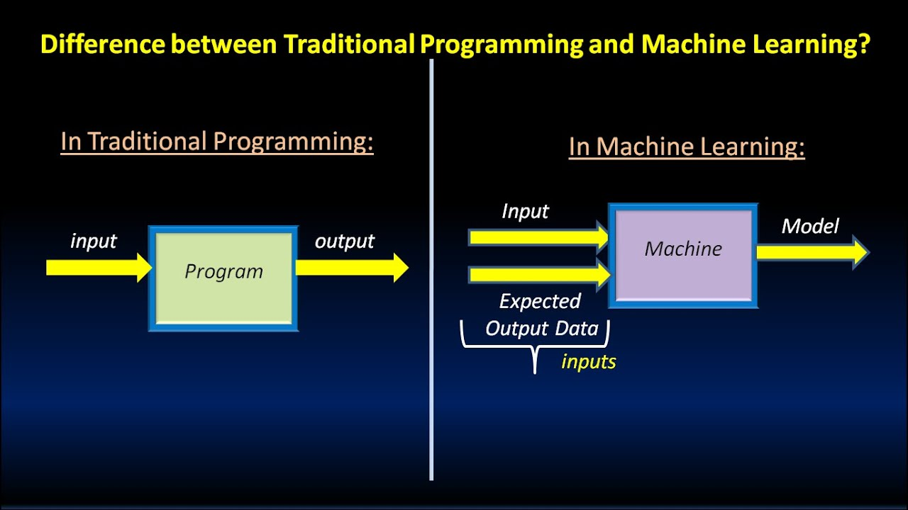

Slide 5
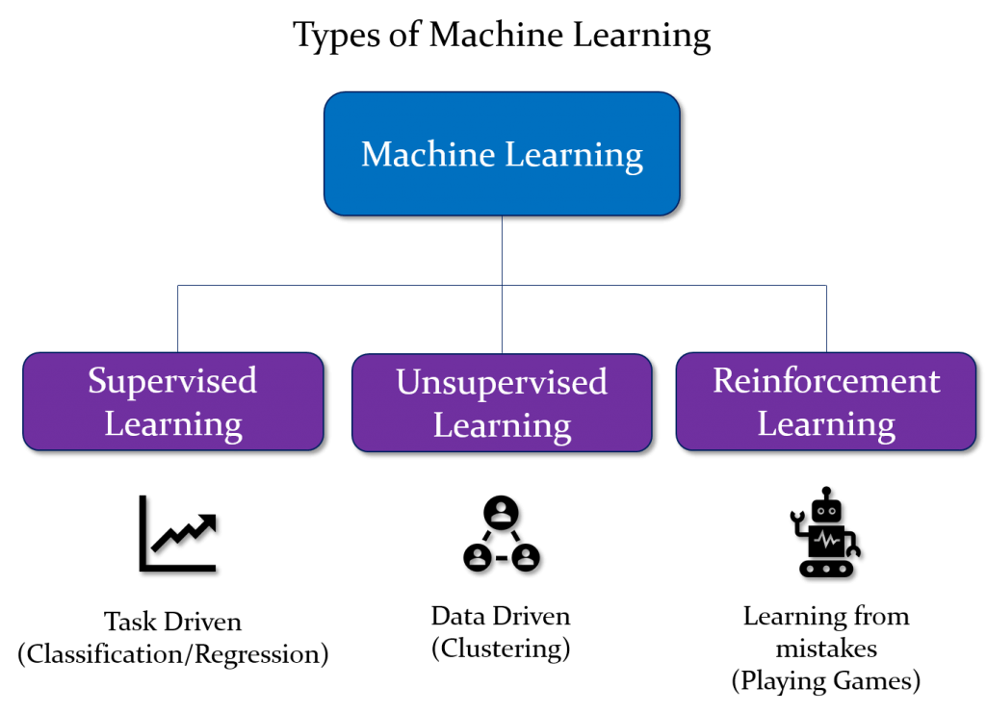

Slide 6
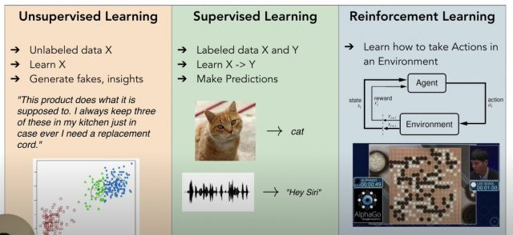

Slide 7
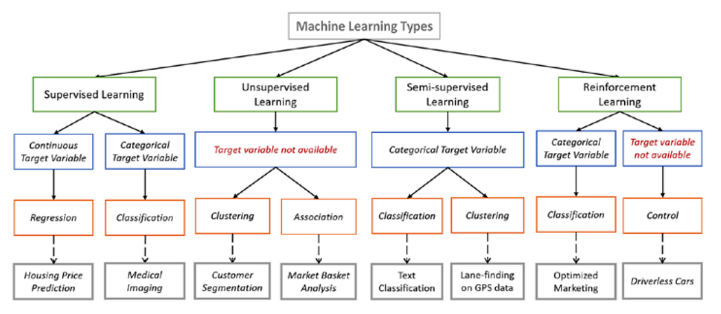

Slide 8
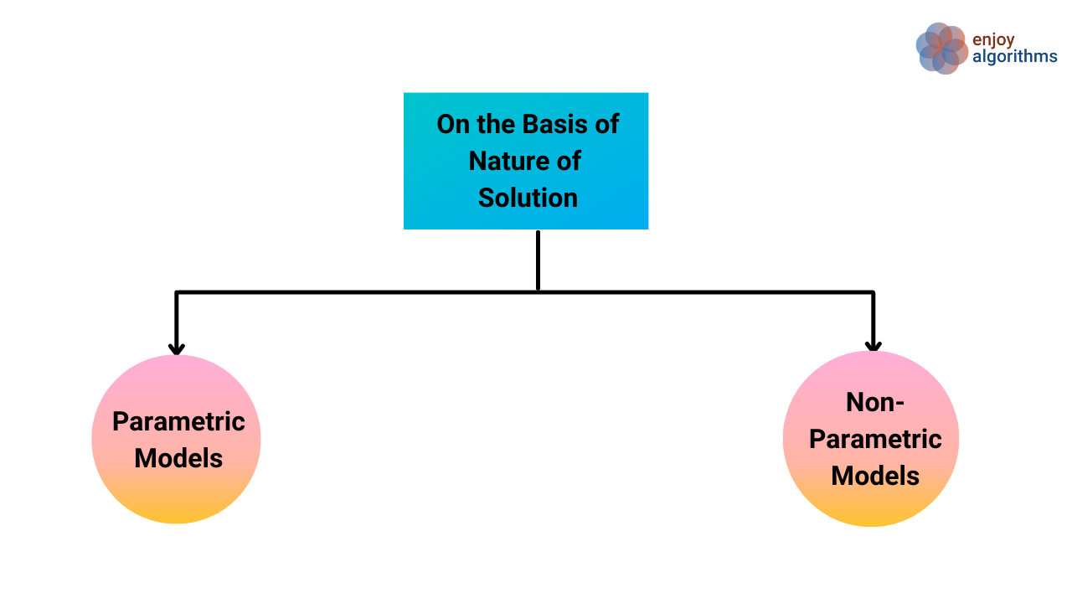

Slide 9
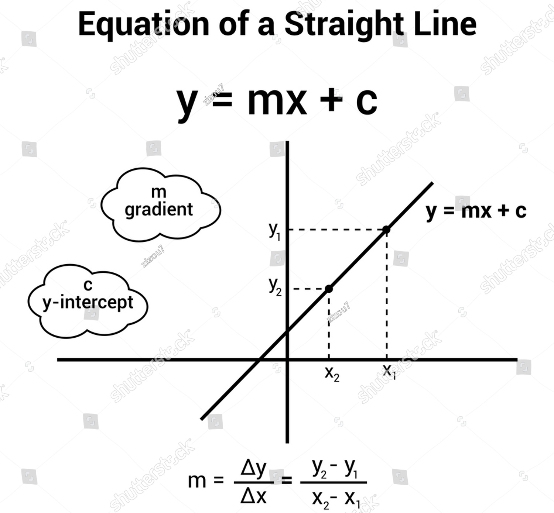
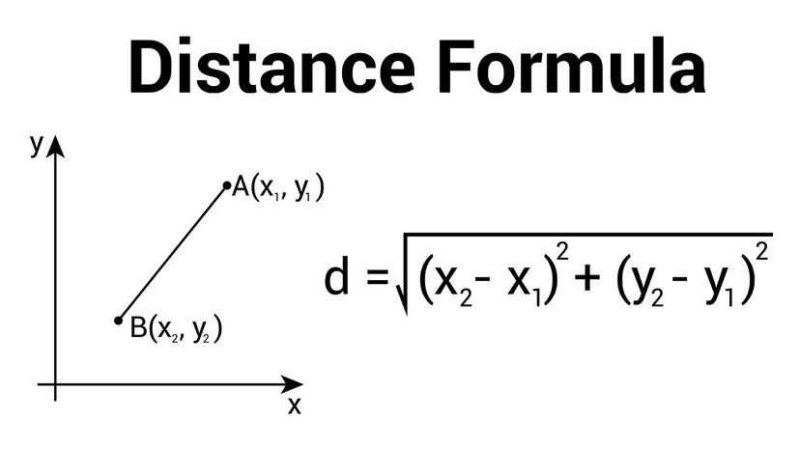

Slide 10
In machine learning, models are broadly classified into parametric and non-parametric models based on how they learn and generalize from data.
Use Cases of Parametric Models:
Linear Regression: Predicting house prices based on square footage.
Logistic Regression: Classifying whether an email is spam or not.
Naive Bayes: Sentiment analysis and document classification.
Advantages of Parametric Models:
Computationally efficient.
Easier to interpret and understand.
Requires less data to train.
Disadvantages of Parametric Models:
Limited flexibility due to fixed functional form.
May underfit complex patterns in data.
How to Improve Parametric Models:
Feature engineering to improve model expressiveness.
Regularization techniques (e.g., L1 and L2 penalties) to prevent overfitting.
Using ensemble techniques like bagging or boosting.
Parametric Models
Parametric models are characterized by a fixed number of parameters. These models make assumptions about the data's distribution and structure. Once trained, they summarize the data using a predefined mathematical form.
Key Characteristics:
Fixed number of parameters.
Requires fewer data points to train.
Faster to train and predict.
Strong assumptions about data distribution.
Examples of Parametric Models:
Linear Regression
Equation:
Logistic Regression
Equation:
Naive Bayes Classifier
Support Vector Machines (with linear kernel)
Artificial Neural Networks (with fixed architecture)
https://medium.com/analytics-vidhya/parametric-and-nonparametric-models-in-machine-learning-a9f63999e233

Slide 11
Non-Parametric Models
Advantages of Non-Parametric Models:
Can capture complex data patterns.
Minimal assumptions about data distribution.
More adaptable to real-world data.
Disadvantages of Non-Parametric Models:
Computationally intensive for large datasets.
Prone to overfitting without proper regularization.
Interpretation can be challenging.
How to Improve Non-Parametric Models:
Prune decision trees to avoid overfitting.
Use cross-validation to tune hyperparameters (e.g., number of neighbors in k-NN).
Combine models using ensemble methods for better generalization.
Non-parametric models do not assume a fixed form for the underlying data distribution. Instead, they learn the structure of the data from the training dataset, allowing greater flexibility to model complex relationships.
Key Characteristics:
No fixed number of parameters.
More data-dependent.
Higher flexibility and accuracy for complex patterns.
Requires more data and computational resources.
Examples of Non-Parametric Models:
k-Nearest Neighbors (k-NN)
Decision Trees
Random Forests
Support Vector Machines (with non-linear kernels)
Gaussian Processes
Use Cases of Non-Parametric Models:
k-NN: Recommender systems (e.g., recommending movies to users).
Decision Trees: Customer segmentation in marketing.
Random Forests: Predicting medical diagnoses from patient records.

Slide 12
Comparison: Parametric vs. Non-Parametric Models
Feature | Parametric Models | Non-Parametric Models
Number of Parameters | Fixed and finite | Varies with data size
Flexibility | Limited by functional form | Highly flexible
Training Speed | Fast | Slower for large datasets
Data Requirements | Works well with small data | Requires more data
Interpretability | Easier to interpret | Harder to interpret
Example Algorithms | Linear Regression, Naive Bayes | Decision Trees, k-NN

Slide 13
Conclusion
Choosing between parametric and non-parametric models depends on the specific use case:
Parametric Models: Preferred for simpler, faster tasks where interpretability matters and data is limited.
Non-Parametric Models: Ideal for complex problems where capturing intricate patterns is crucial, even at the cost of computational efficiency.
Balancing model complexity and data availability is key to successful machine learning applications.

Slide 14
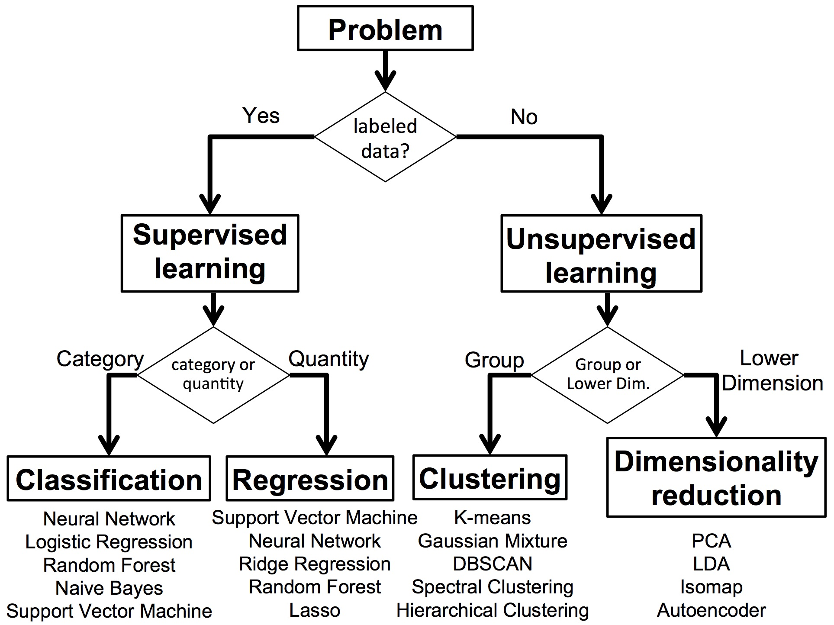

Slide 15
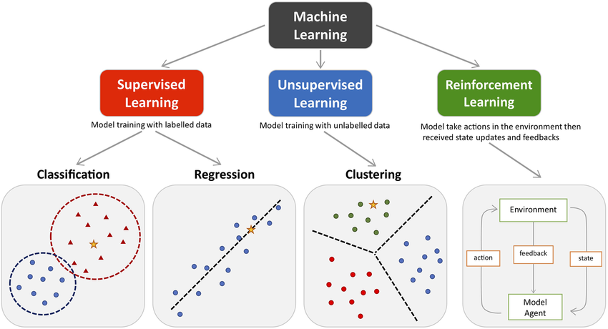

Slide 16
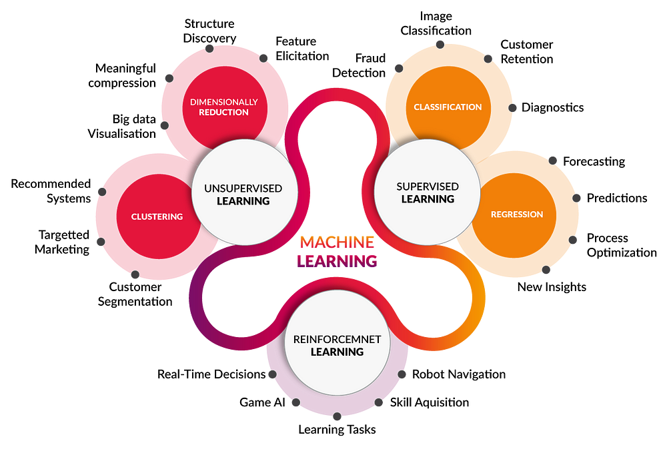
Examples use case

Slide 17
Supervised
In Supervised learning, you train the machine using data which is well "labeled."
It means data is already tagged with the correct answer.
It can be compared to learning which takes place in the presence of a supervisor or a teacher.
A supervised learning algorithm learns from labeled training data, helps you to predict outcomes for unforeseen data.
One disadvantage of this learning method is that the dataset has to be hand-labeled either by a Machine Learning Engineer or a Data Scientist. This is a very costly process, especially when dealing with large volumes of data.

Slide 18
Unsupervised
Unsupervised Learning is a machine learning technique in which the users do not need to supervise the model.
Instead, it allows the model to work on its own to discover patterns and information that was previously undetected.
It mainly deals with the unlabeled data.
Unsupervised learning problems are grouped into clustering and association problems.
The most basic disadvantage of any Unsupervised Learning is that it’s application spectrum is limited.

Slide 19
Semi-supervised learning is the type of machine learning that uses a combination of a small amount of labeled data and a large amount of unlabeled data to train models.
Intuitively, one may imagine the three types of learning algorithms as :
Supervised learning where a student is under the supervision of a teacher at both home and school.
Unsupervised learning where a student has to figure out a concept himself.
Semi-Supervised learning where a teacher teaches a few concepts in class and gives questions as homework which are based on similar concepts.
Semi-supervised

Slide 20
Reinforcement learning is the training of machine learning models to make a sequence of decisions.
In this approach, machine learning models are trained to make a series of decisions based on the rewards and feedback they receive for their actions.
The machine learns to achieve a goal in complex and uncertain situations and is rewarded each time it achieves it during the learning period.
Reinforcement learning is different from supervised learning in the sense that there is no answer available, so the reinforcement agent decides the steps to perform a task.
The machine learns from its own experiences when there is no training data set present.
Reinforcement

Slide 21
Based On | Supervised machine learning | Unsupervised machine learning
Input Data | Algorithms are trained using labeled data. | Algorithms are used against data which is not labelled
Computational Complexity | Supervised learning is a simpler method. | Unsupervised learning is computationally complex
Accuracy | Highly accurate and trustworthy method. | Less accurate and trustworthy method.

Slide 22
The goal of machine learning is to develop methods that can automatically detect patterns in data, and then to use the uncovered patterns to predict future data or other outcomes of interest.
-- Kevin P. Murphy

Slide 23
ML key terms that you must know!

Slide 24
Features
Features are the fields used as input.
A feature is one column of the data in your input set.
For instance, if you're trying to predict the type of pet someone will choose, your input features might include age, home region, family income, etc.
Feature means property of your training data.
A feature is the input you have fed to the model or system.
The value of x variable in simple linear regression are the features.

Slide 25
Label
The output you get from your model after training is called a label.
A label is the thing we're predicting.
For example the value of y variable in simple linear regression model is the label.
Suppose you give your model data like a person’s age, height, hair length and then your model predicts whether the person is male or female. Then male or female is called the label.

Slide 26
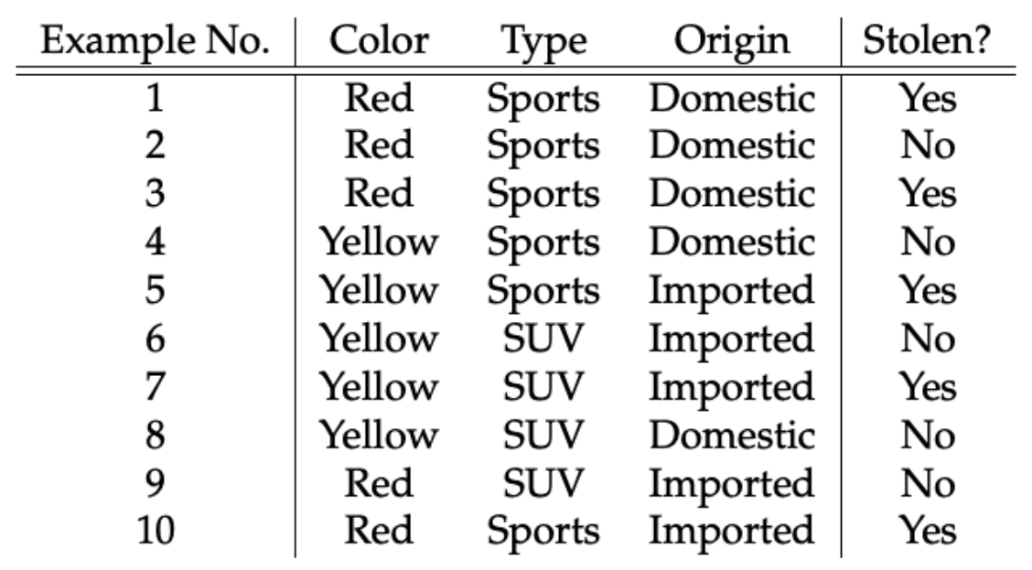
Tabular data to predict whether car is stolen or not?
Features
Label

Slide 27
Model
A model is the relationship between features and the label.
An ML model is a mathematical model that generates predictions by finding patterns in your data.
ML Models generate predictions using the patterns extracted from the input data.
A model represents what was learned by a machine learning algorithm.
The model is the “thing” that is saved after running a machine learning algorithm on training data and represents the rules, numbers, and any other algorithm-specific data structures required to make predictions.

Slide 28
Data
ML Algorithm
ML Model

Slide 29
Steps in ML
1. Data collection
2. Data preparation
3. Choose a ML model
4. Train the model
5. Evaluate the model
7. Make predictions
6. Parameter tuning

Slide 30
1. Data collection
Data collection is the process of gathering and measuring information from countless different sources.
This is a critical first step that involves gathering data from various sources such as databases, files, and external repositories.
Before starting the data collection process, it’s important to articulate the problem you want to solve with an ML model.

Slide 31
Data preparation/pre-processing techniques generally refer to the addition, deletion, or transformation of training set data.
Since the collected data may be in an undesired format, unorganized, or extremely large, further steps are needed to enhance its quality. The three common steps for preprocessing data are formatting, cleaning, and sampling.
Data preparation (also referred to as “data preprocessing”) is the process of transforming raw data so that data scientists and analysts can run it through machine learning algorithms to uncover insights or make predictions.
2. Data Preparation

Slide 32
3. Choose a ML model
For different purpose, different ML models are available. So it depends on the need that which ML model must be selected.
The choice of ML model to be selected depends on many factors like the problem statement and the kind of output you want, type and size of the data, the available computational time, number of features, and observations in the data, etc.

Slide 33
4. Train the model
The process of training an ML model involves providing an ML algorithm (that is, the learning algorithm) with training data to learn from.
Let's say that you want to train an ML model to predict if an email is spam or not spam.
You would provide ML model with training data that contains emails for which you know the target (that is, a label that tells whether an email is spam or not spam). Then the model should be trained by using this data, resulting in a model that attempts to predict whether new email will be spam or not spam.

Slide 34
5. Evaluate the model
Model evaluation is a method of assessing the correctness of models on test data. The test data consists of data points that have not been seen by the model before.
There are two methods of evaluating models in data science, Hold-Out and Cross-Validation.
To avoid overfitting, both methods use a test set (not seen by the model) to evaluate model performance.

Slide 35
Each model has its own sets of parameters that need to be tuned to get optimal output.
For every model, our goal is to minimize the error or say to have predictions as close as possible to actual values. This is one of the cores or say the major objective of hyperparameter tuning.
There are following three approaches to Hyperparameter tuning:
Manual Search
Random Search
Grid Search
6. Parameter Tuning

Slide 36
“Prediction” refers to the output of an algorithm after it has been trained on a historical dataset.
Machine learning has two main goals:
prediction and inference.
After you have a model, you can use that model to generate predictions which means to give your model the inputs it has never seen before and obtain the answer the model has predicted.
In addition to making predictions on new data, you can use machine-learning models to better understand the relationships between the input features and the output target which is known as inference.
7. Make predictions

Slide 37
Applications
Of
ML
Traffic Alerts
Social Media
Transportation and Commuting
Products Recommendations
Virtual Personal Assistants
Self Driving Cars
Dynamic Pricing
Google Translate
Online Video Streaming
Fraud Detection

Slide 38
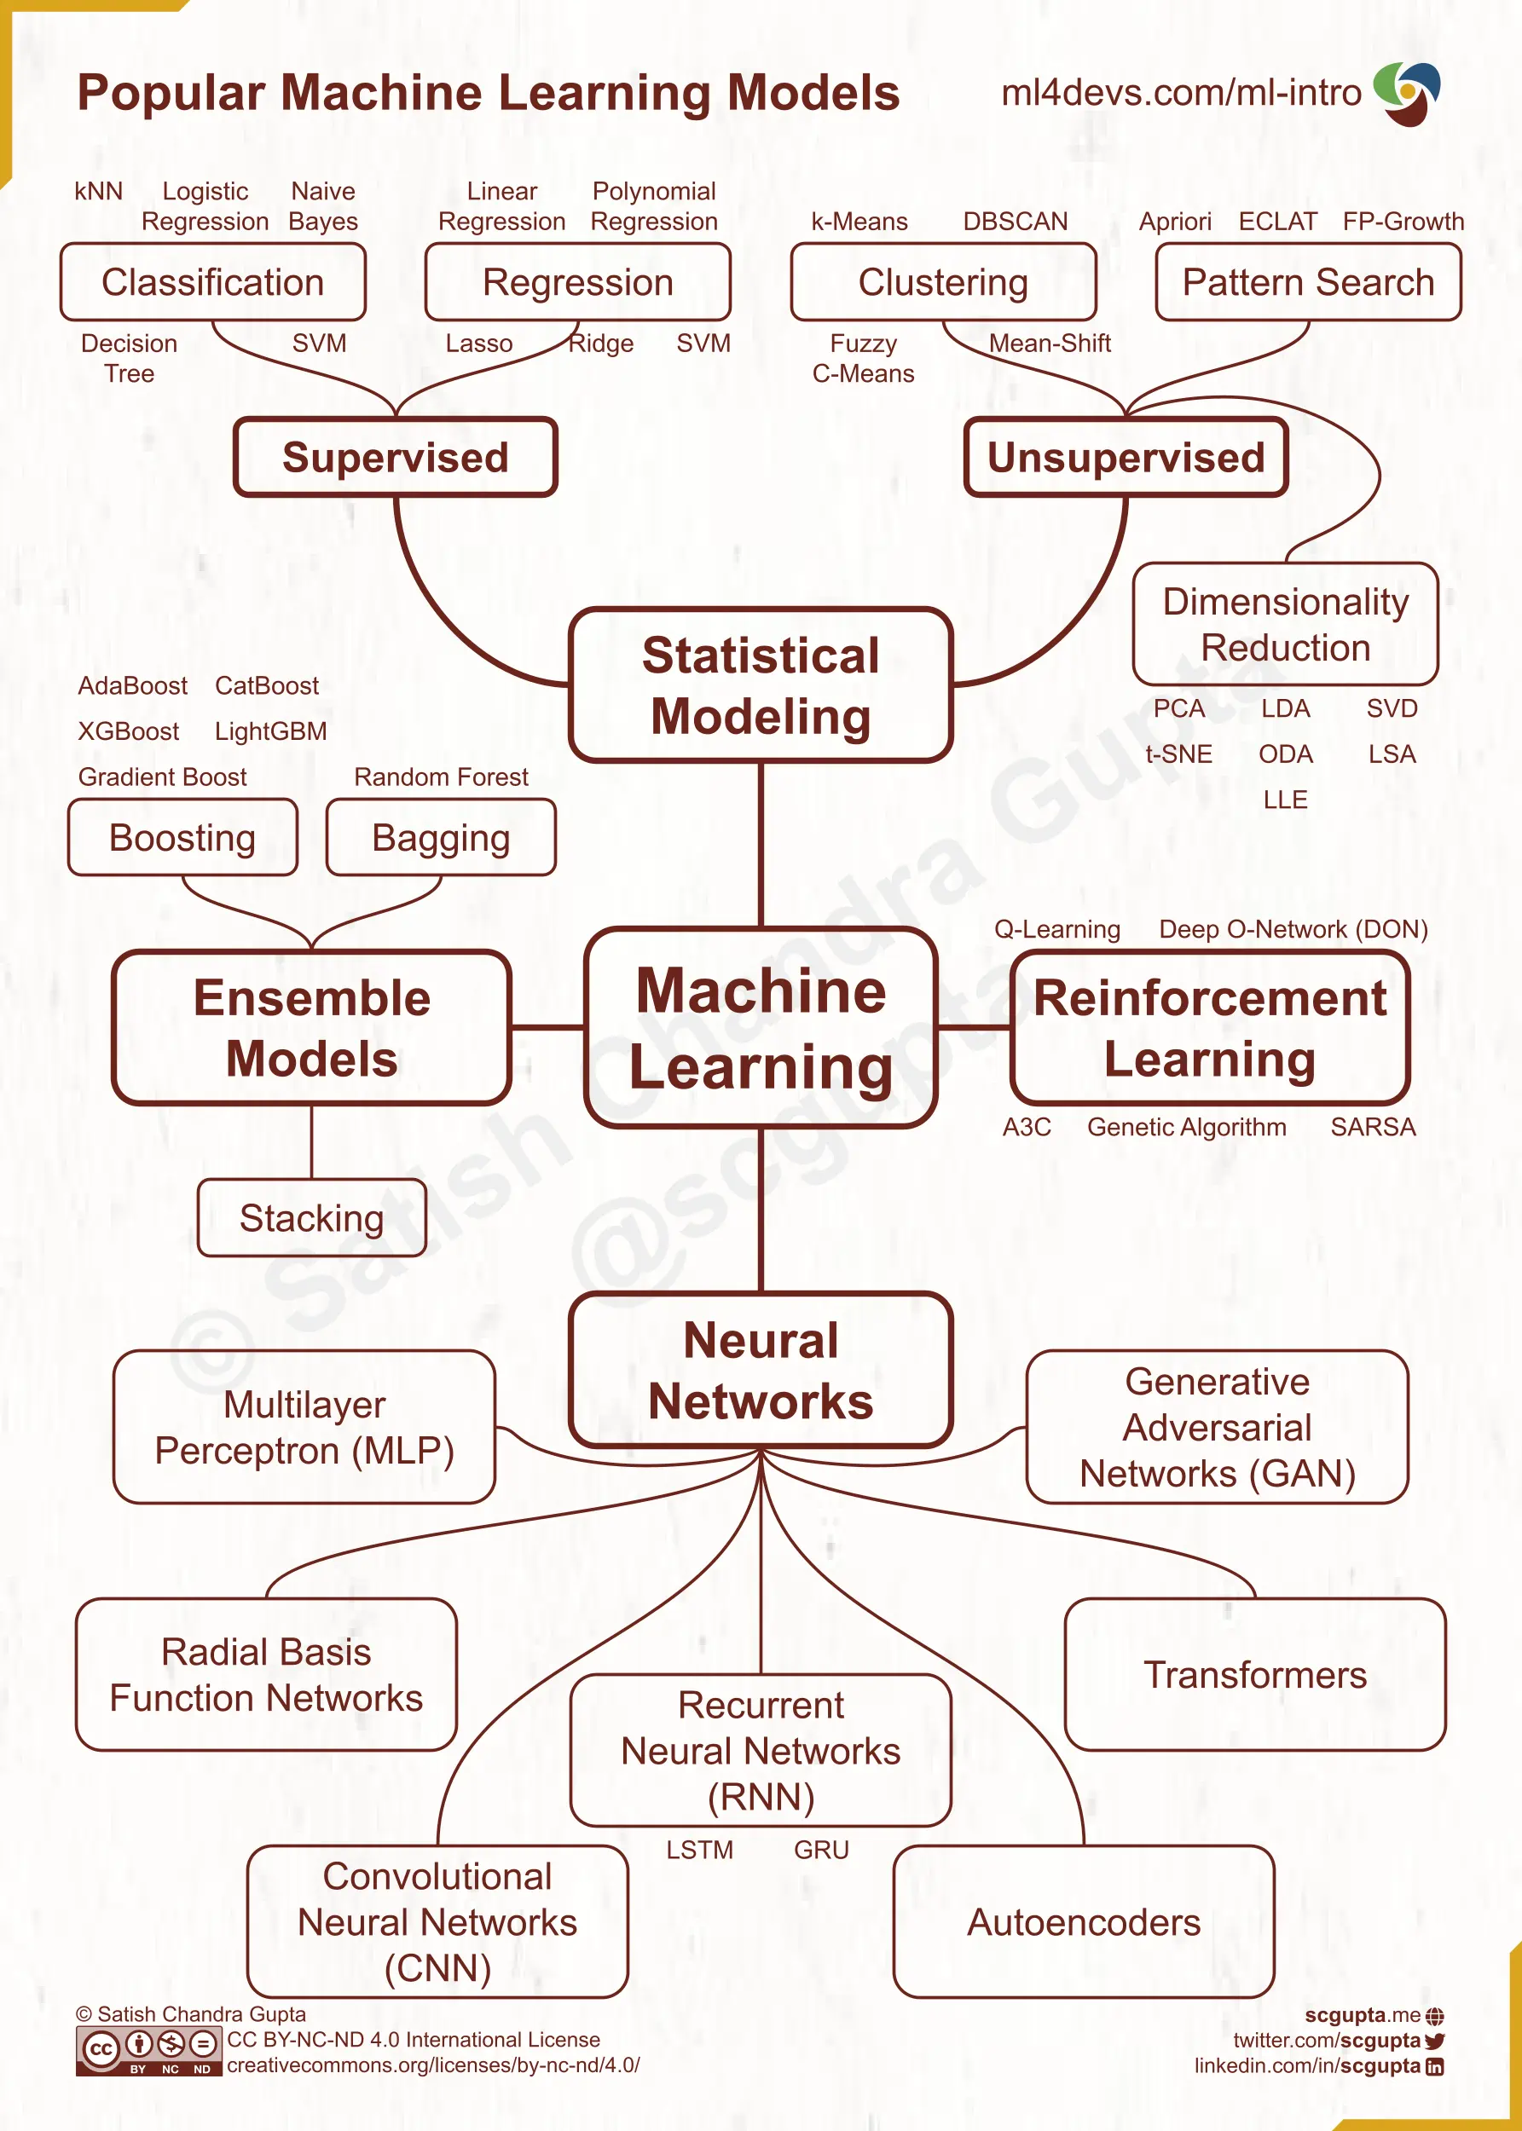
https://pythonnumericalmethods.studentorg.berkeley.edu/notebooks/chapter25.01-Concept-of-Machine-Learning.html

Slide 39
